Slide 1
Pokémon Top Trumps

Slide 3
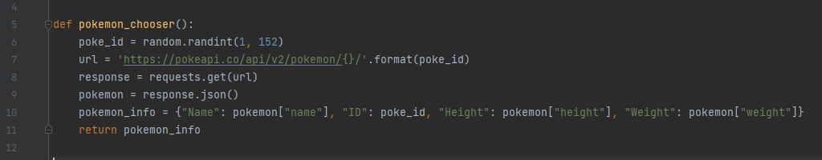
Required Tasks: Pokemon Top Trumps
1. Generate a random number between 1 and 151 to use as the Pokemon ID number
2. Using the Pokemon API get a Pokemon based on its ID number
3. Create a dictionary that contains the returned Pokemon's name, id, height and weight (★
https://pokeapi.co/)
1
2
3

Slide 4
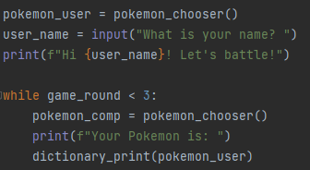
Required Tasks: Pokemon Top Trumps
4. Get a random Pokemon for the player and another for their opponent

Slide 5
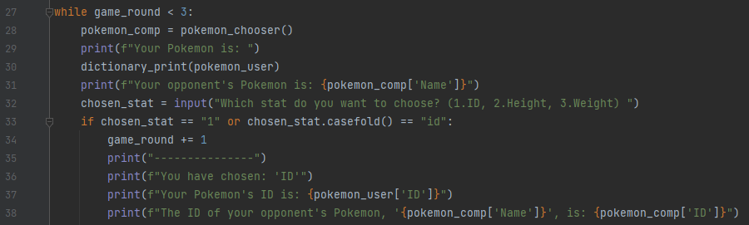
Required Tasks: Pokemon Top Trumps
5. Ask the user which stat they want to use (id, height or weight)

Slide 6
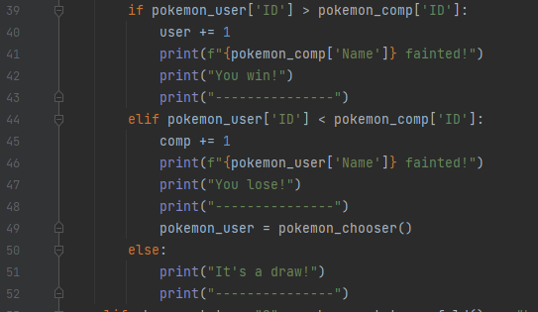
Required Tasks: Pokemon Top Trumps
6. Compare the player's and opponent's Pokemon on the chosen stat to decide who wins

Slide 7
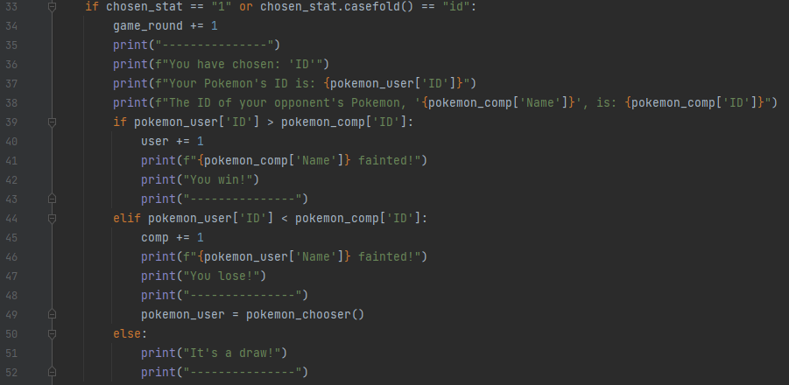

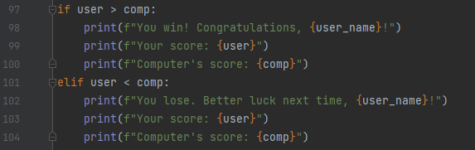
Extension Task: Pokemon Top Trumps
Play multiple rounds and record the outcome of each round. The player with most number
of rounds won, wins the game

Slide 8


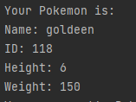
Challenging Code that we Solved: Printing out the Dictionary without the brackets
Tidy Code
Original Code

Slide 9
Harry Potter Battle Game

Slide 11
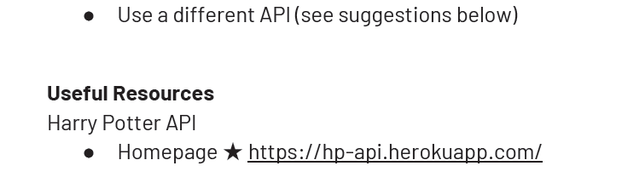
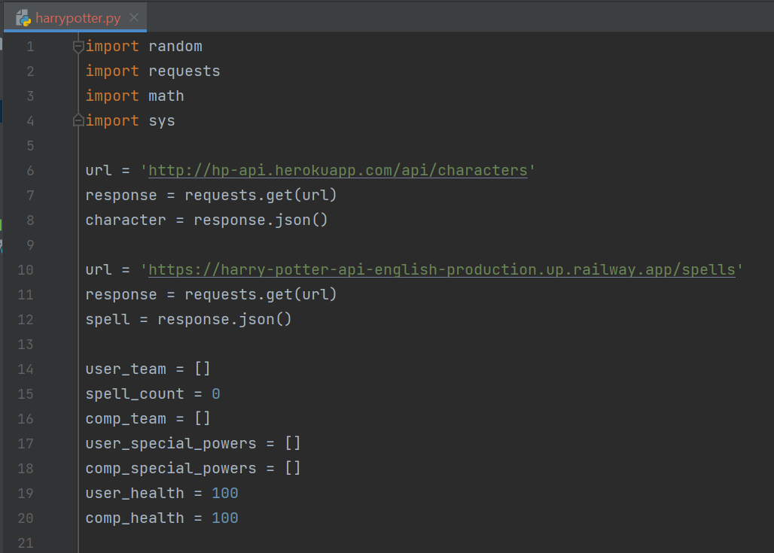
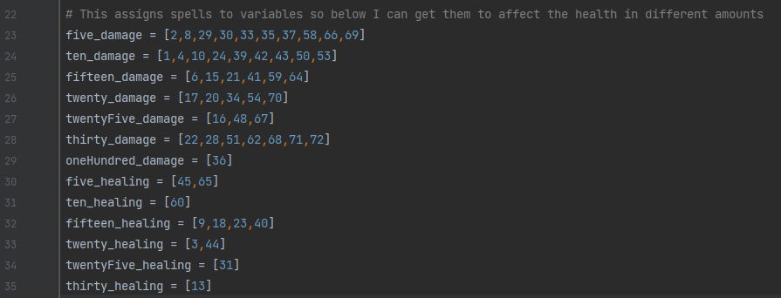
Extension: Harry Potter battle game
modules
APIs
variables and lists

Slide 12
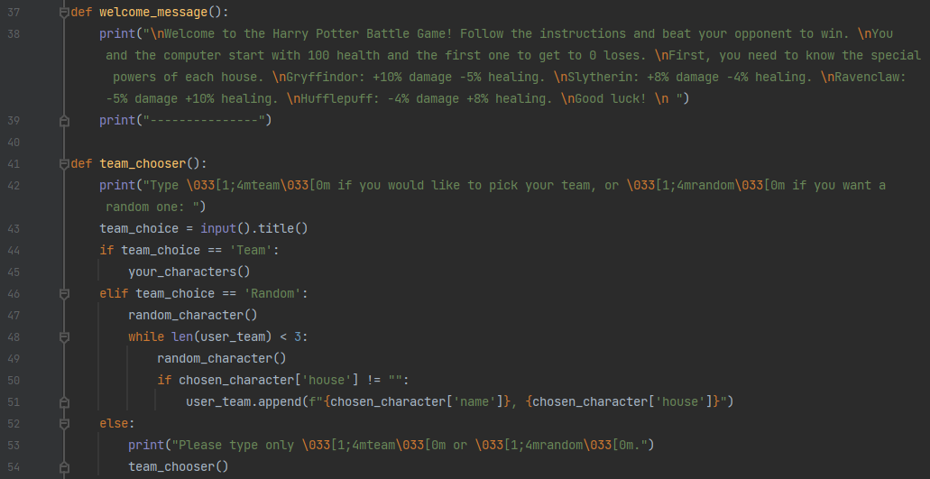
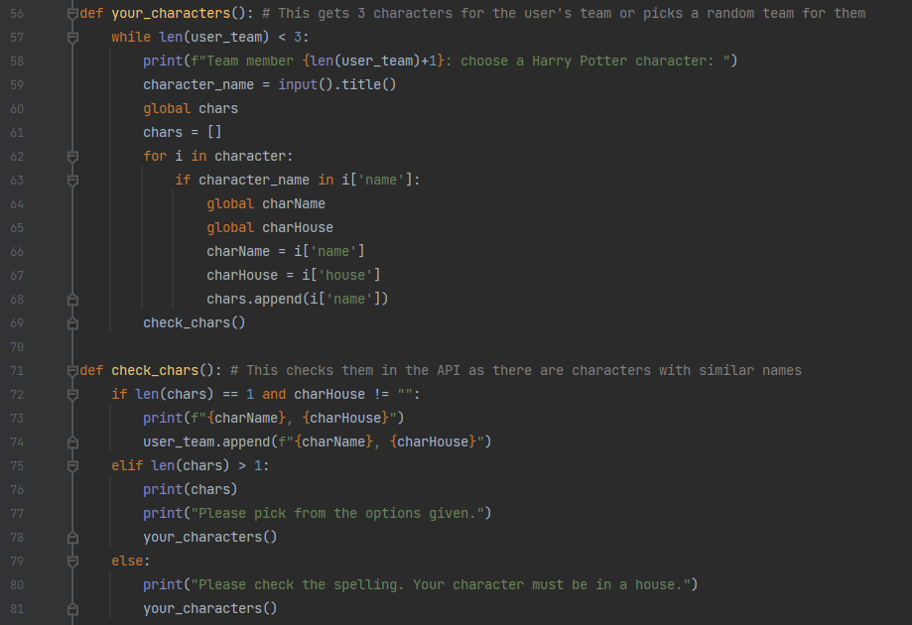
Harry Potter battle game: Functions
If statements
While loop
For loop
Appending to lists
Filtering user input

Slide 13
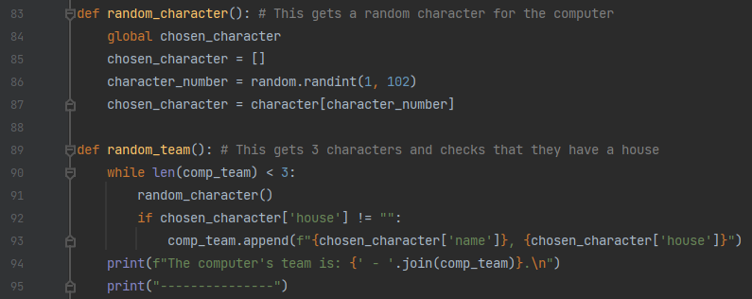
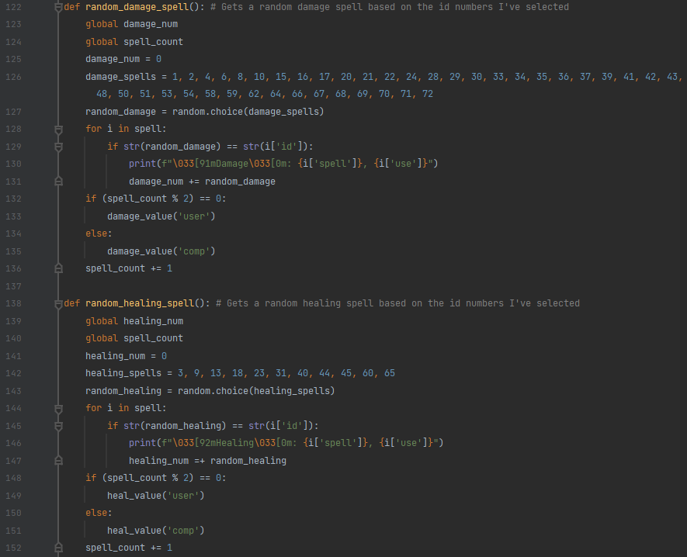
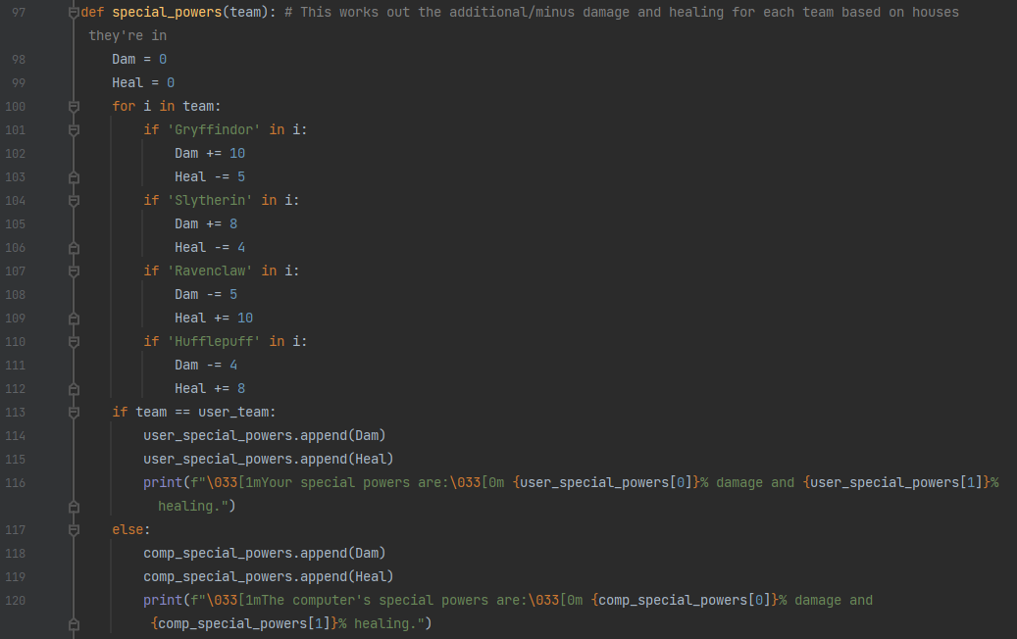
Harry Potter battle game: Functions
String interpolation
Using odd/even to check turns
Passing argument into function

Slide 14
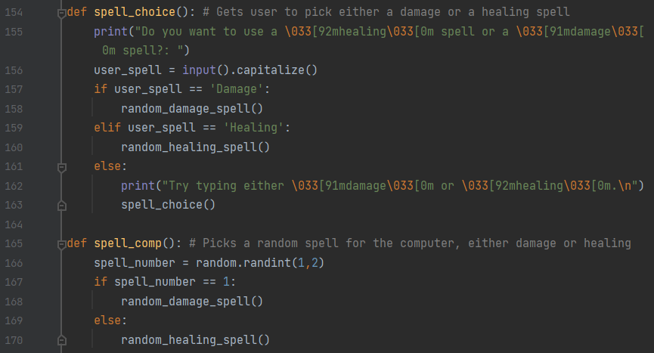
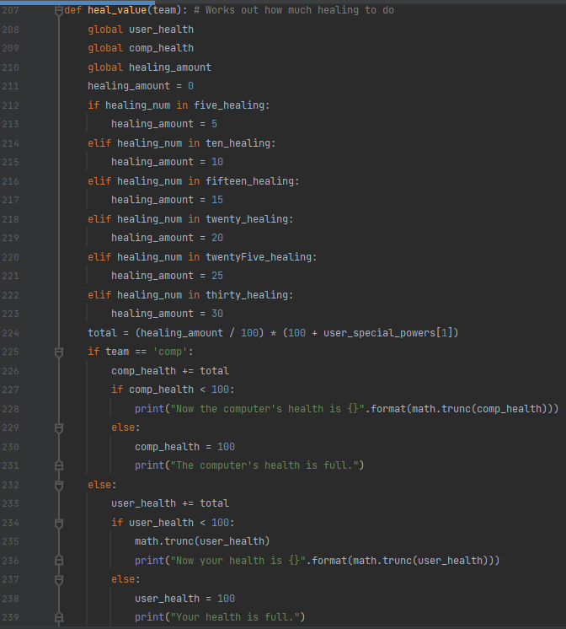
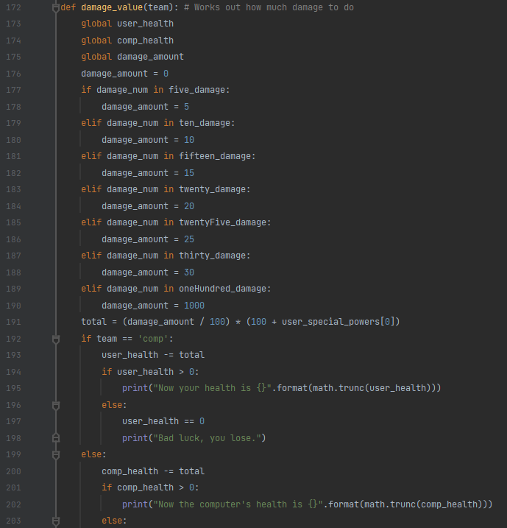
Harry Potter battle game: Functions
Text effects
Setting spell scores
Global variables

Slide 15
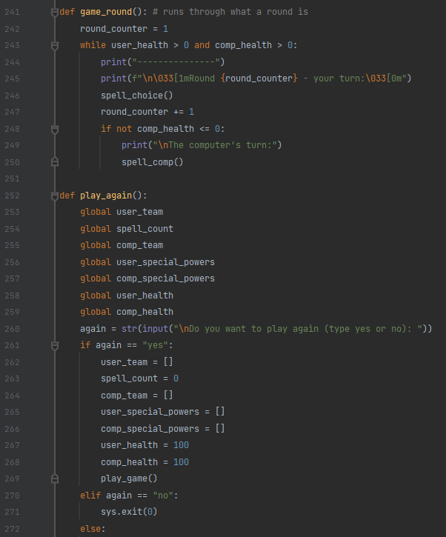
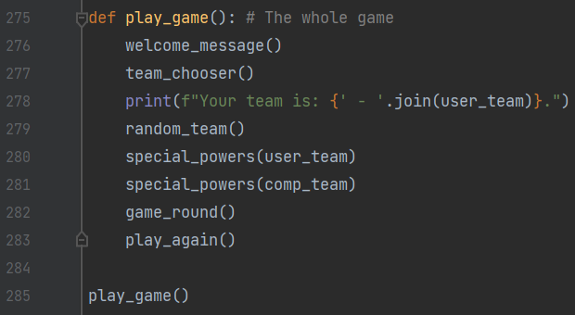
Harry Potter battle game: Functions
Function that runs entire game
Resetting variables
Calling functions within functions – reusing code.

Slide 16
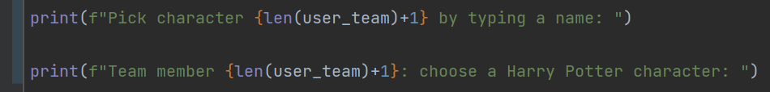
We coded some parts together, working on solving problems and checking each other’s code. We made suggestions such as putting certain parts in functions and printing lists and dictionaries in a more aesthetically pleasing way.
We have refined the code through replaying it and still recognise parts where there could be improvements.
We asked friends to test the games and incorporated the feedback, for example:

